Slide 1

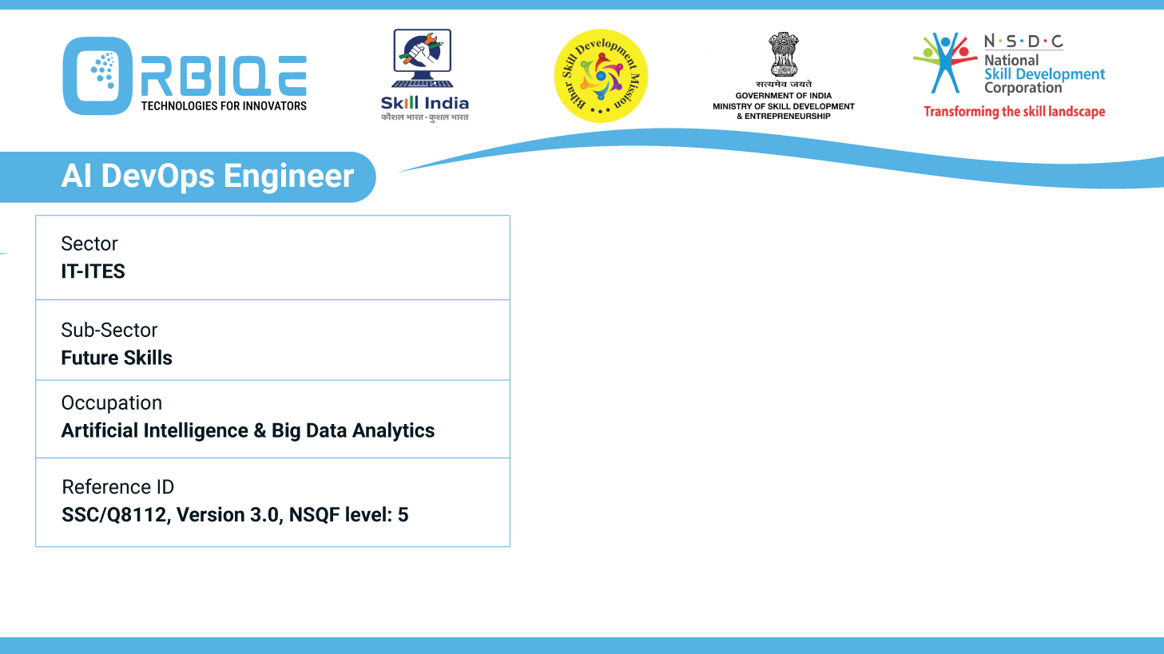
Name- Krishna Kant Dubey

Slide 2

Developing a CI/CD Pipeline

Slide 3
Agenda
Implement a CI/CD pipeline
Automate development
Testing
Deployment processes

Slide 4
Implement a CI/CD pipeline

Slide 5
Automate development

Slide 6
Testing

Slide 7
Deployment processes

Slide 8
Thank You

